Slide 1


Norfolk and Suffolk
NHS Foundation Trust
MP Briefing
Wednesday 9 July 2025

Slide 2

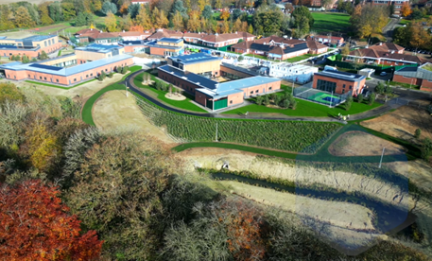


NSFT provides specialist mental health and learning disability care for people across Norfolk and Suffolk.
We work with NHS and social care partners, service users, carers, the voluntary sector and the police to provide integrated health and social care mental health services in community and inpatient settings.
Population
served across Norfolk and Suffolk
44
Beds across Norfolk and Suffolk
1.6m
430
New £55 million Rivers Centre at Hellesdon – opened January 2025
£390m
Owned and leased community and inpatient sites
Planned income 2025-26
34
£375m
Notes:
Data from NSFT Quality Account April 2024 – March 2025

Slide 3
516,013 Secondary mental health
service contacts
58,828: New episodes of care in
secondary mental health services
1,842: Patients who had an inpatient stay
41,559 People entered the Improving Access to Psychological
Therapies service
4,847
Permanent members of staff (WTE)
592
New people welcomed during 2024/2025
9.4%
Vacancy rate
Notes:
Data from NSFT Quality Account April 2024 – March 2025. Patient data calculated for the period 1 April 2024 to 27 March 2025.

Slide 4

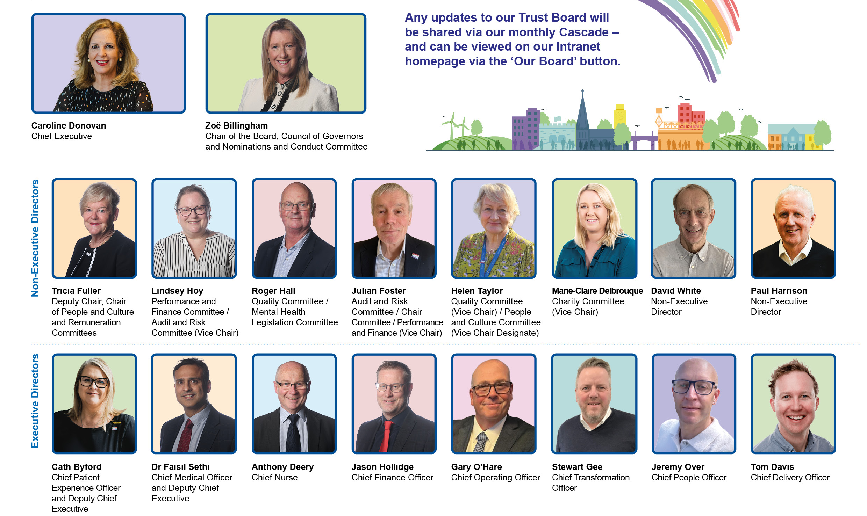
Our Board
The Board of Directors sets the overall strategic direction of our Trust. As members of the Trust’s Board, we are determined and clear on our priorities for the future.

Slide 5


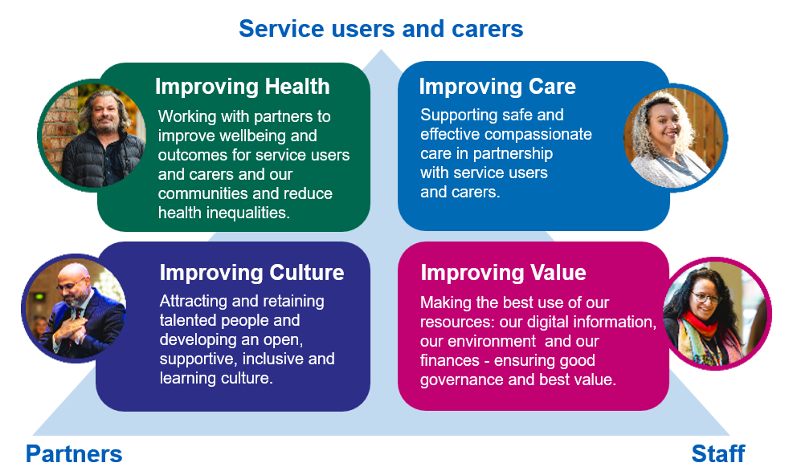
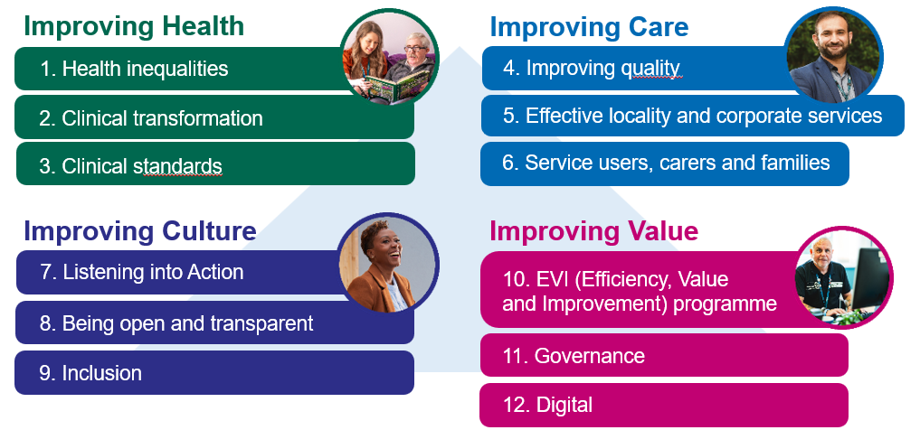


Our NSFT strategic priorities
Our Values
Our Vision
Large scale change programmes 2025/26

Slide 6
Improving Health – Clinical transformation
NSFT currently has five areas of focus for clinical transformation which are:
Each clinical transformation programme will aim to deliver:
Reduction in unwarranted variation across the Trust area; standardised services that meet local needs
Improved access to services through reduction in waiting times and faster response times for care and treatment
Reduction in health inequalities across services
Improved experiences for services users, families and carers
Provision of care closer to home e.g. reduction in inappropriate out of area placements
More efficient care provision, developed in collaboration with our VCSE partners
Service models that closely align with best practice and nationally agreed clinical standards which may result in accredited models of care delivery.
Community Mental Health
Crisis Pathway
Inpatient (adult)
Child Family and Young Persons
Older Persons

Slide 7

Improving Health – Health inequalities
The Trust is developing a new health inequalities strategy with a specific focus on neighbourhood working, suicide prevention and physical health to strengthen our prevention approach and ensure support for our most deprived communities.
Research and population health data will inform and support clinical transformation and service improvement.
Proactive engagement with communities, service users and carers
We will work collaboratively with system partners to develop the strategy and will engage with service users, carers, staff and partners in the coming months.
Clinical engagement will be essential as this may lead to changes in clinical principles and practice.

Slide 8
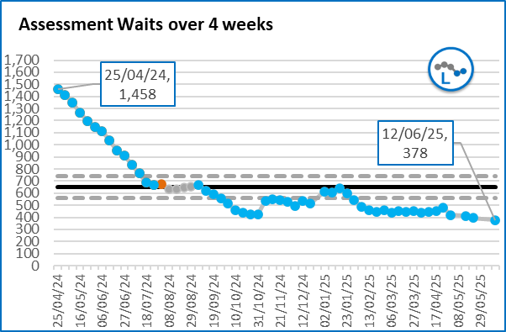
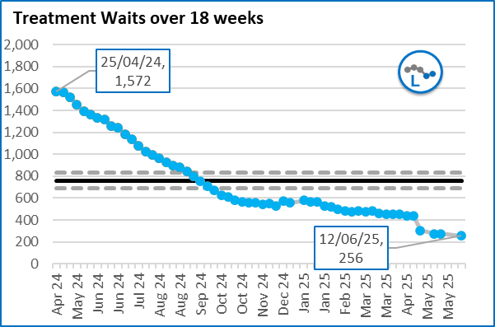
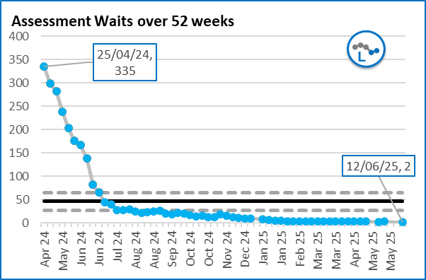
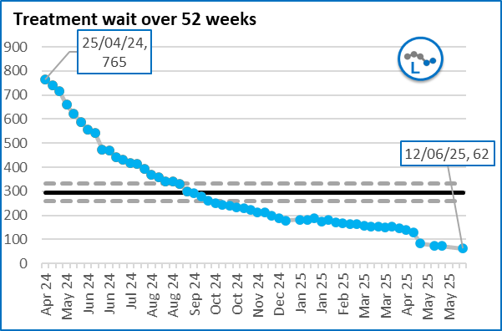
Improving Health – Waiting time improvements
Waiting times and
access to services*
83.7% reduction in the number of patients waiting 18 weeks or longer for treatment since April 2024.
Eradicated 52-week waits for children and young people for assessments in Norfolk and Suffolk.
* Excludes Neurodevelopmental and Memory Assessment Team Waits

Slide 9


Improving Health – Performance 2025/26
Performance as per MH Core Data Pack – April 2025 updated
Indicator | Standard (National target) | National performance | East of England performance | NSFT | RAG against Standard | RAG against England average
Children and Young people (CYP) Mental Health
% of Urgent Eating Disorders Referrals seen within 1 week | 95% | 69% | 49% | 71%
% of Routine Eating Disorders Referrals seen within 4 weeks | 95% | 77% | 78% | 91%
Perinatal Mental Health
Performance against National Plan for Number of Mothers Accessing Perinatal Services | 100% | 105% | 103% | 113%
Adult Mental Health: Community Mental Health (CMH)
% of People with a first episode of psychosis beginning treatment within two weeks of referral | 60% | 67% | 81% | 89%
Adult mental health: NHS Talking Therapies, for depression and anxiety (formerly IAPT services)
Proportion of people who begin treatment for NHS Talking Therapies within six weeks of Referral | 75% | 90% | 91% | 97%
Proportion of people who begin treatment for NHS Talking Therapies within 18 weeks of Referral | 95% | 99% | 97% | 100%
NHS Talking Therapies: Proportion of Service users displaying Reliable Improvement | 67% | 69% | 68% | 69%
NHS Talking Therapies: Proportion of Service users displaying Reliable Recovery | 48% | 48% | 50% | 51%
Crisis and acute care and use of the Mental Health Act (MHA)
% of people followed up within 72 hours of discharge from an inpatient ward | 80% | 72% | 69% | 86%
Acute hospital mental health liaison
Percentage of new referrals to liaison psychiatry teams from A&E seen within one hour | None set | 68% | 73% | 81%

Slide 10
Improving Health – NHS Neurodevelopmental Services
We provide most Neurodevelopmental Services in Suffolk and adult ADHD services in Norfolk.
We have seen a significant increase in demand that outstrips our capacity causing waiting lists to grow.
Around 50% of referrals we receive do not meet the evidence-based criteria for assessment and treatment.
This is a national issue that has been recognised in the recent national ADHD Taskforce report, and we are working closely with our system partners including commissioners, primary care and education partners.
Actions we are identifying to reduce waiting times throughout this year, include:
Taking a needs led approach, instead of first come first serve.
Improving the efficacy of the team through the use of digital teams and redesigning roles and responsibilities.
Working with our system partners to develop a stepped care model that uses primary care, VCSE, schools, and social care.

Slide 11
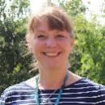



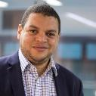

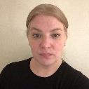
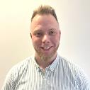

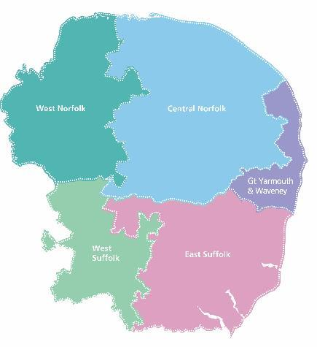



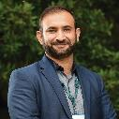
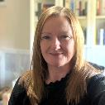
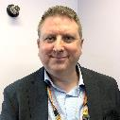
Improving Care – Future Leadership Structure
Central Norfolk
Nicky Shaw Director of Nursing and Quality
Dr Dan Dalton Medical Director
Michelle O’Donnell Director of Operations
West Norfolk
Kate McCandlish Director of Nursing and Quality
Dr Zeyn Green-Thompson Medical Director
Mark Catling Director of Operations
Great Yarmouth and Waveney
Tracey Holland Director of Nursing and Quality
Dr Sarah Maxwell Medical Director
Saru Mutema Director of Operations
West Suffolk
Daisy Mudoni Director of Nursing and Quality
Dr Sarah Cornick Medical Director
Elaine Deazley-Morgan Director of Operations
East Suffolk
Belinda Danso-Langley Director of Nursing and Quality
Dr Sohail Abrar Medical Director
Pete Henson Director of Operations

Slide 12
Improving Care – Increased Clinical Leadership
Sample leadership structure for our five localities
Professional leadership Director of Psychology, Principal Pharmacist, Principal AHP,
Patient Participation Lead
Triumvirate leadership Medical Director Director of Operations
Director of Nursing and Quality
Corporate support Governance Lead, Business Support Manager, HR, Finance and IT Business Partners
Significantly increased Clinical Leadership
Inpatients, access and urgent care
Community
Associate Director of Operations
Associate Director of Nursing and Quality
Children and YP, Adult and Older Adult leadership, each with:
Associate Medical Director Associate Director of Psychology AHP Lead
Specialist
31 additional Community Matrons appointed
Associate Medical Director Associate Director of Operations Associate Director of Nursing and Quality
Associate Medical Director Associate Director of Operations Associate Director of Psychology AHP Lead
Operational management
Community Operational Manager Community Matron
Executive Team,
Non-Executive Directors and Governors are all aligned to localities
Acute Care Operational Manager Matrons
Children and YP Operational Manager Community Matron
Community (OP) Operational Manager Community Matron
Specialist Operational Manager Community Matron

Slide 13

Improving Care – Corporate services redesign
Redesigning Corporate Services
To make sure our corporate services are of high quality and can effectively support our clinical staff to deliver better outcomes for service users, carers and families.
To make sure they align and integrate much more closely with our five clinical localities.
To be more efficient and make processes more streamlined and consistent.
To deliver a structure that supports career development and opportunities within NSFT.

Slide 14

Improving Care – Improving quality
We will have had 8 CQC inspections in 10 years.
We are an improving Trust,
moving from NOF4 to NOF3 in early 2025.
Our priority is sustainable improvement
2015 | 2016 | 2017 | 2018 | 2020 | 2022 | 2023
Inadequate | Requires Improvement | Inadequate | Inadequate | Requires Improvement | Inadequate | Requires Improvement

Slide 15

Improving Care – CQC Key Headlines
Clinical Services Assessment
(March 2025):
Focused on Adult CMHTs, Crisis Teams, and HBPoS across five localities.
Staff were praised for being respectful, caring, and welcoming.
Positive examples of teamworking and innovation noted.
Early signs of impact from leadership and governance changes.
All recommendations are being actively progressed.
Well-Led Inspection (May 2025):
Staff described as passionate, committed, and seeing improvements.
New governance and locality model seen as a strong foundation but more to do to embed
Stakeholder relationships significantly improved.
Cultural improvements have been recognised, but more work is needed to ensure all staff feel confident using Freedom to Speak Up (FTSU) processes.
Embedding Equality, Diversity and Inclusion (EDI) remains a priority, with a focus on progressing the Patient and Carer Race Equality Framework (PCREF).

Slide 16

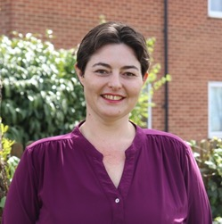
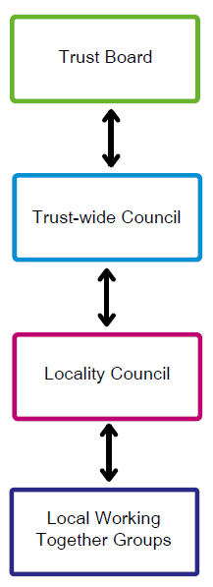
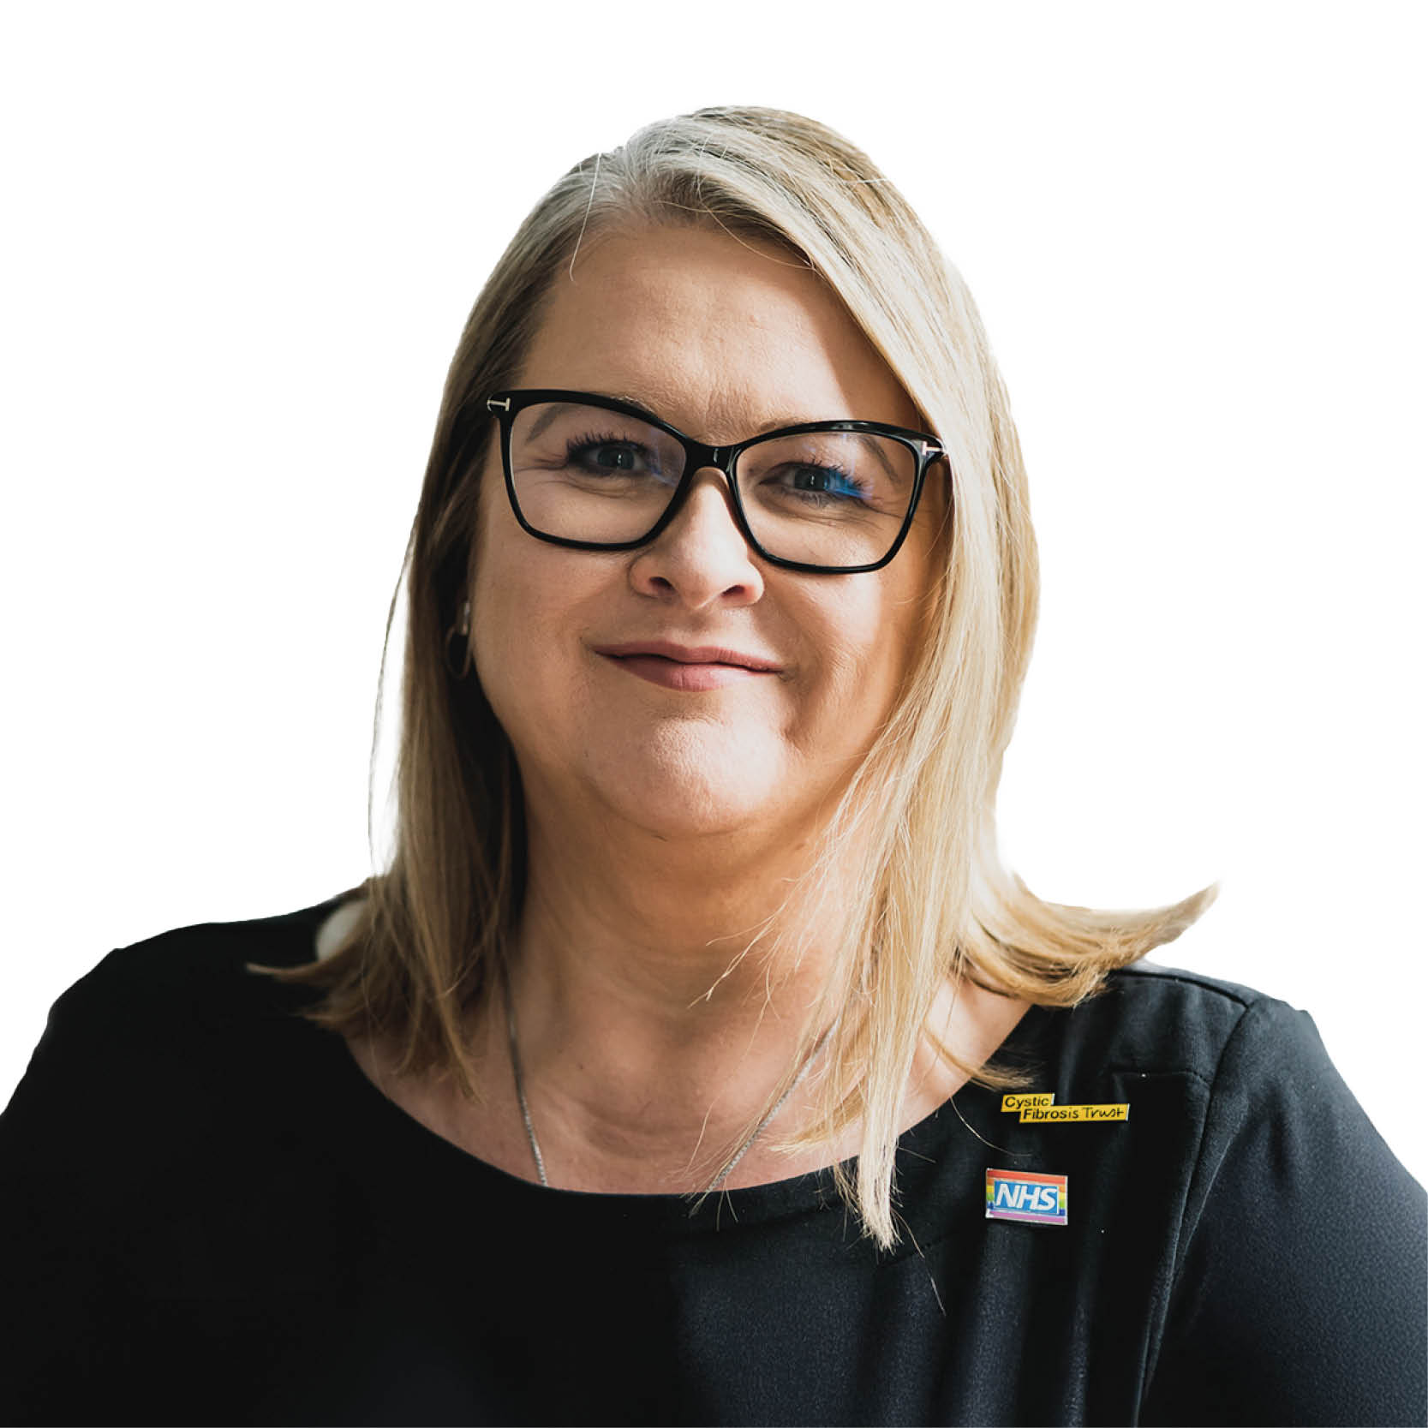
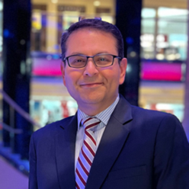

Improving Care – Service users, carers and families
Service User and Carers
Chief Patient Experience Officer
New Service User and Carer Council and plan for five Locality Councils
Chair of the Service User and Carer Council will attend Board meetings
Co-production partner commissioned (Rethink)
Relationship building with Campaign to save mental health services in Norfolk and Suffolk
Development and engagement on the Trust’s first Carers Charter
Cath Byford
Chief Patient Experience Officer
Tallia Langston
Service User and Carer Council Co-chair
Nikant Ailawadi
Director of Patient Experience

Slide 17
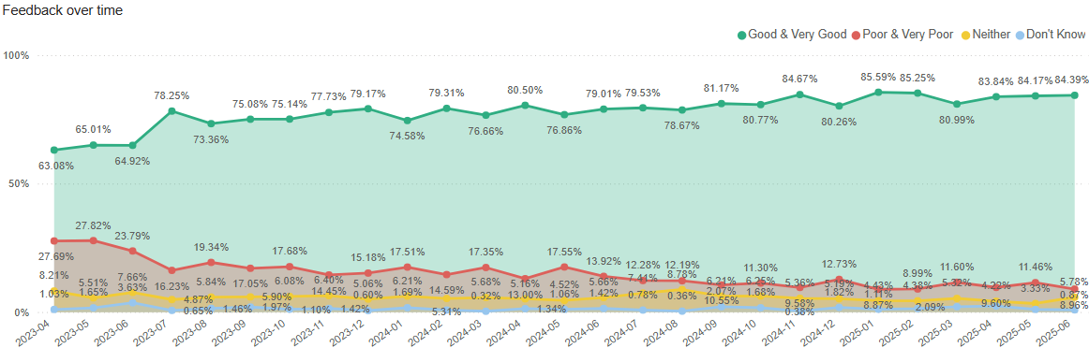
Improving Care – Service users, carers and families
Improving Culture
Friends and Family Test response improvements
Feedback has improved:
Very good/good:
Apr 2023 - 63%
June 2025 – 84%
Very poor/poor
Apr 2023 – 28%
June 2025 – 6%
Response rates are as follows:
2023/4: 3739
2024/5: 5570 – a 49% increase in responses

Slide 18


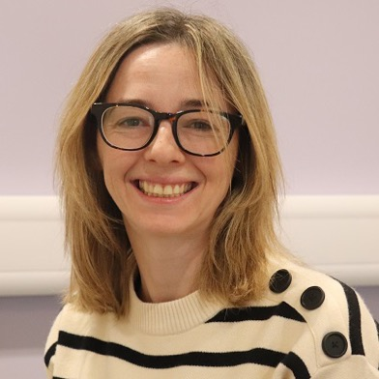

Improving Culture
Being Open and Transparent
New Freedom to Speak Up service launched February 2025
Of people responded 100% would use FTSU service again
52 Speak Up Champions have been appointed across all localities and corporate services.
Dear Caroline launched February 2025
Responses received have been solution focused
Only 20% of responses have been submitted anonymously demonstrating a more open culture
Holly Stephens
Head of Speaking Up
Ivraine Macivan-Davies
Speaking Up Manager
Notes:
Reporting period month of June 2025

Slide 19

Improving Culture – Listening into Action
100% increase in capacity for memory assessments, reducing waiting times
Increased the take up of clinical supervision from 30% to 71%.
Healthcare Support Worker recruitment – streamlined from 6 weeks to only 14 days.
Introducing a GP Advice Line and text messaging updates for service users
LiA Quick Wins - Since March 2024
Over 170 Quick Wins
LiA Pioneer Wave 1 and 2 Teams
33 Pioneer Teams, plus 11 care delivery teams
Over 15k Intranet views since launch
LiA teams
Pulse check results up to 32% higher than all other responders.
Senior leaders
Leadership Audit results
showing improvement for senior leaders

Slide 20


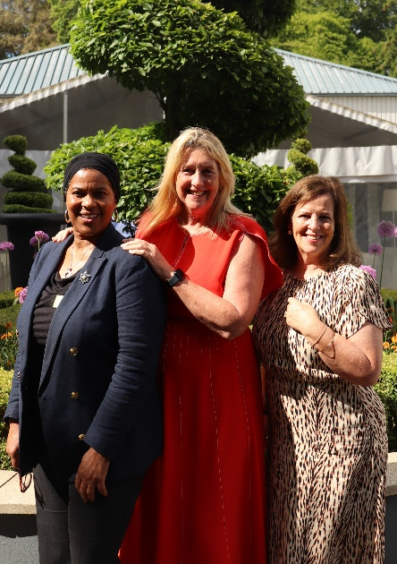


Improving Culture – Inclusion: a focus on race
Race equality deep diagnostic report completed by Excellence in Action.
Race Equity Conference – held on 20 May 2025 with over 200 colleagues in attendance
Race Equity Strategic Plan - to be agreed at Trust Board in July.
“This was not just another event, stories of people, their truth, vulnerability, courage, and humanity. No other event has cut through my heart, finer or deeper. It matters when the Executive Team doesn’t just speak values but models them. That’s what I saw today. And that is what makes me believe that the future of NSFT is one of equity and belonging.” Samuel Jude, Community Team Manager

Slide 21


Improving Culture – Our people
A net increase of 110 nurses over the last 12 months.
Nursing vacancy level lowest in five years - down from 20% to 14%.
Successful newly qualified nurse recruitment campaign – with 80 mental health nurses due to be offered roles across the Trust this year.
NHS Staff Survey 2024 – still much to do
Medical vacancy rate has reduced from 22% in 2020 to 12% in March 2025.
Our overall staff turnover reduced from 17% to 12% in last 2 years.
New monthly TALK Awards launched in April – 340 nominations
Over 630 nominations.
50 finalists celebrated at awards event for 300 colleagues, service users and carers, partners and sponsors.
Over 100 resident doctors with a very positive experience:
Teamworking – NSFT 92% vs 76% national average
Teaching and Learning – NSFT 82% vs 67% national average
Quality of Care – NSFT 84% vs 73% national average

Slide 22
Improving Culture – Being open and transparent
Summary results from our independent Stakeholder Survey of partners (Autumn 2024)
QA1: How would you rate NSFT’s approach to partnership working?
QA2: Is NSFT involving and engaging with the right individuals and organisations on key decisions?
“It is improving - the exec leadership within the Trust has dramatically changed, this has shone through in the Listening into Action process and this has been a huge driver for change”.
Anonymous
Overall recognition of improvement 90%
Overall recognition of improvement 76%
QB1: How would you rate their openness and transparency?
QB2: Do you feel they are getting better at listening to the views of patients and the public?
“Getting better, they are now involving the right people to make certain decisions - especially in light of the geography they work across”.
Anonymous
Overall recognition of improvement 81%
Overall recognition of improvement 72%

Slide 23

Improving Value – Efficiency, Value and Improvement
We must become more efficient whilst improving the quality of our services.
We need to address our underlying financial deficit – our on-going costs are currently higher than the income we receive.
Our efficiency requirement is 5% (£18.7m) for this year – we need to deliver permanent efficiencies and improvements in value.
Our EVI (Efficiency, Value and Improvement) programme consists of eight Trust-wide workstreams:
Productivity – capacity to care
Flow, length of stay and out of Trust placements
Temporary staffing – Bank and Agency
Medical workforce
Clinical pathway re-design and provider collaborative
Corporate redesign
Workforce optimisation
Trust-wide efficiencies

Slide 24


